Slide 1
THEORY OF COMPUTATION
Dr.S.Prince Mary M.E.,Ph.D., Associate Professor,
Department of Computer Science and Engineering,
School of Computing
SATHYABAMA
Institute of Science and Technology
Deemed to be University
Chennai.

Slide 2
UNIT- II CONTEXT-FREE LANGUAGES AND NORMAL FORMS

Slide 3
SYLLABUS
Context-free grammars
More examples
Union, concatenations, and *’s of CFLs
Derivation trees and ambiguity
Unambiguous CFG for algebraic expressions
Normal Forms – CNF – GNF

Slide 4
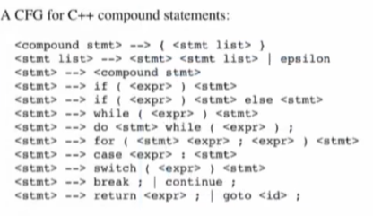
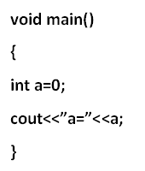
Need for CFG
C++ Program

Slide 5
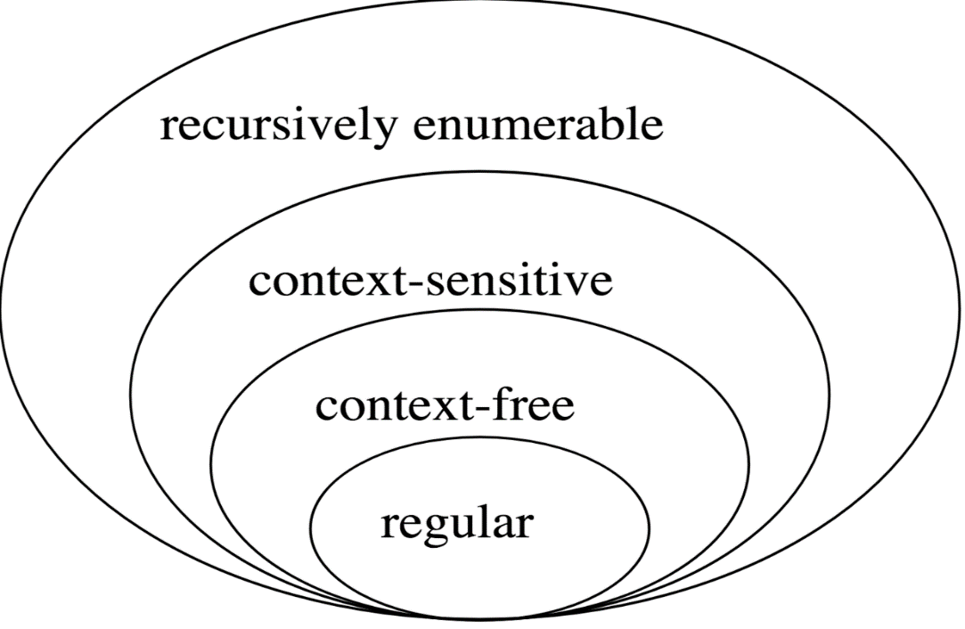
What is Context-free grammar?
It is defined as a formal notation or a model for describing natural language or programming language.
Application:
Compilers – Parser Phase

Slide 6
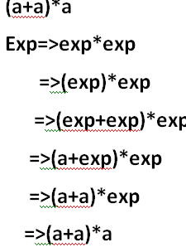
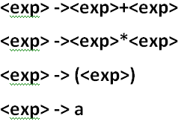
Example-Production Rule

Slide 7
Formal Definition of CFG
Definition − A context-free grammar (CFG) consisting of a finite set of grammar rules is a quadruple
G= (N, T, P, S)
Where,
N is a set of non-terminal symbols.
T is a set of terminals where N ∩ T = NULL.
P is a set of rules, P: N → (N ∪ T)*, i.e., the left-hand side of the production rule P does have any right context or left context.
S is the start symbol.
Example
The grammar ({A}, {a, b, c}, P, A), P : A → aA, A → abc.
The grammar ({S}, {a, b}, P, S), P: S → aSa, S → bSb, S → ε
The grammar ({S, F}, {0, 1}, P, S), P: S → 00S | 11F, F → 00F | ε

Slide 8
Construction of CFG
Construct the CFG for the language having any number of a's over the set ∑= {a}
RE=a*
P2:
Q → aQ
Q → ε
G=({S},{a, ε },P2,Q}
N={S}
T={a, ε }
S= Start Symbol
Derive a string "aaaaaa", we can start with start symbols. S => aS =>aaS rule 1 =>aaaS rule 1 =>aaaaS rule 1 =>aaaaaS rule 1 =>aaaaaaS rule 1 =>aaaaaaε rule 2 =>aaaaaa

Slide 9
2. Construct a CFG for a language
L = {wcw^{R} | where w € (a, b)*}.
Strings= {aacaa, bcb, abcba, bacab, abbcbba,...}
P1:
S → aSa rule 1
S → bSb rule 2
S → c
G= ( {S} ,{a,b,c} , P, {S})
Derive: abbcbba Derivation: S =>aSa => abSba from rule 2 => abbSbba from rule 2 => abbcbba from rule 3 =>abbcbba

Slide 10
3.Construct a CFG for the language L = a^{n}b^{2n} where n>=1.
String = {abb, aabbbb, aaabbbbbb....}.
P:
S → aSbb | abb
Tuples: G =({S},{a,b},P, {S})
Derive: aabbbb
Derivation
S =>aSbb
=>aabbbb

Slide 11
4. Design a CFG for a language accepting balanced parenthesis.
T={ (,),{,},[,] }
w= { (),{},[],(()),({[]}), …….}
P:
S->(S) /[S]/{S} / SS
S-> ε
5. Design a CFG for a language accepting Arithmetic Expression
T={ +, -, *, /, a }
P:
E->E+E/E-E/E*E/ E/E / (E) / a
Derive: ({[]}) Derivation: S=> ( S) =>( { S } ) =>( { [ s ] } ) =>( { [ ] } )
Drive- a+a-a Derivation: E=>E+E =>E+E-E =>a+E-E =>a+a-E =>a+a-a

Slide 12
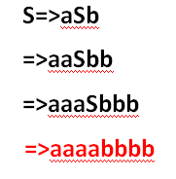
Given a CFG, find the Language generated by G
i. G=(N,T,P,S) where N={S}, T={a,b} P={S→aSb, S→ab}
S=>ab
S=>aSb
=>aaSbb
=>aaabbb
S=>aSb
=>aabb
W={ab,aabb,aaabbb,.....}
Ans: L={ a^{n} b^{n} / n>=1 }

Slide 13


ii. G=(P,{Ꜫ,0,1},P,P}, P:P→0 | 1 |Ꜫ |0P0 |1P1
P=>0
P=>1
P=>Ꜫ
P=>0P0
=>000
P =>1P1
=>10P01
=>101P101
=>1010101
W={Ꜫ,0,1,010,101,11011,…}
Ans: L={Language of Palindromes}

Slide 14

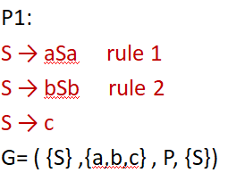
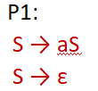
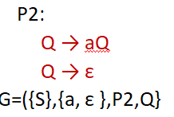

Slide 15

Context Free Language and Regular Grammar
CFL:
A language L is said to be a CFL if there is a CGF , G such that L=L(G).
Let G =(N,T,P,S ) be a CFG, The Language Generated by G is
Regular Grammar:
A regular grammar is a mathematical object, G, with four components,
G = (N, Σ, P, S),
where P is in any of the following form
A → aB, A → a , A → ε
for A, B ∈ N, a ∈ Σ, and ε the empty string

Slide 16

Union, Concatenation and * of CFL’s
Statement: The context-free languages are closed under union, concatenation and Kleene closure.
Theorem: IF L1 and L2 are CFL, the languages L1UL2, L1.L2 and L1* are also CFL’s.
Proof: If we start with CFG’s
G1=(N1,T1,P1,s1), G2=(N2,T2,p2,S2)
G1, and G2 generates L1 and L2 respectively,
Case 1: L(G) ⊆ L1UL2
A Grammar, Gu=(N, T, P,S) generating L1UL2
N=N1UN2U{S}
where, S is the new symbol not in N1 or N2
Then , P= P1 UP2U{S->S1|S2}
Hence, if x ∈ L(G1) then
And we start the derivation with S->S1
Similarly, if x ∈L(G2) then
and we start the derivation with S->S2
Therefore, L(G) ⊆ L1UL2

Slide 17
Case 2: L(G) ⊆ L1.L2
A Grammar, Gu=(N, T, P,S) generating L1UL2
N=N1UN2U{S}
where, S is the new symbol not in N1 or N2
Then , P= P1 UP2U{S->S1.S2}
Hence, if x ∈ L1L2 then x=x12 where x1 ∈L1 and x2 ∈L2
And we start the derivation with
S=>S1S2=>*x1S2 =>*x1x2=x
Hence L(G) ⊆ L1.L2
Case 3: L(G*) ⊆ L1*
A grammar G=(N,T,P,S) generated by L1*
Where,
N=N1 U {S}
P = P1U{ S->S1S|ε}
Hence L(G*) ⊆ L1*
Hence:
The context-free languages are closed under union, concatenation and Kleene closure.

Slide 18
CFG for RE
Obtain the CFG for the RE (011+1)*.(01)*
(011+1) :
A->011|1
(011+1)* :
B->AB |ε
(01) :
C->01
(01)* :
D->CD| ε
(011+1)*.(01)*
S->BD
B->AB / ε
A->011/1
D->CD/ ε
C->01

Slide 19
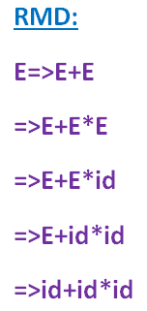
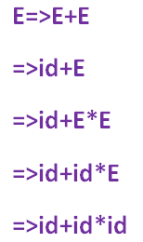
Derivation
Process of deriving a string using the grammar
Types :
Left Most Derivation (LMD)
Right Most Derivation (RMD)
Example :
E->E+E|E-E|E*E|E/E|(E)|id
String : id+id*id
LMD

Slide 20
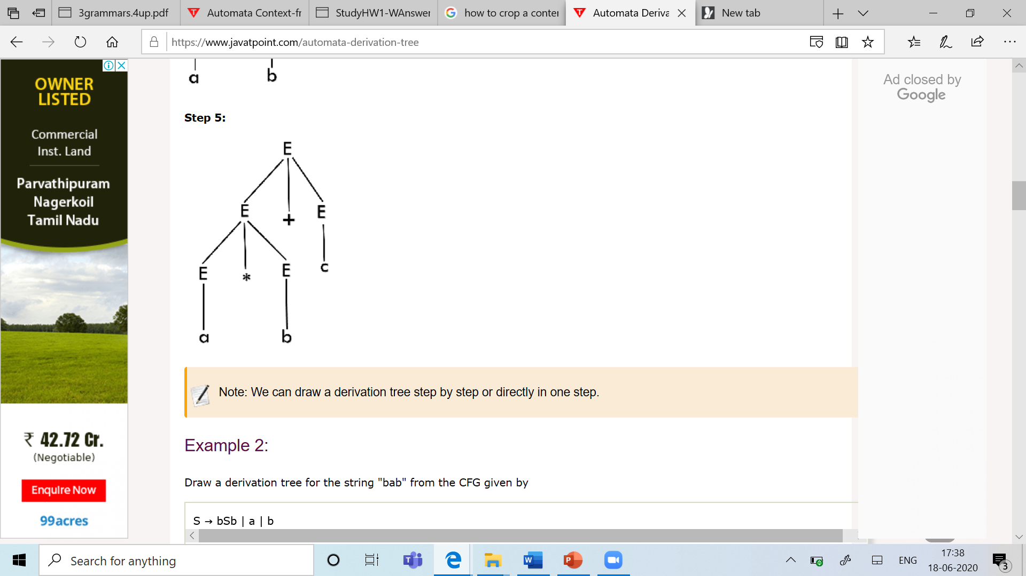
Derivation trees and Ambiguity
Derivation tree is a graphical representation for the derivation.
Called as Parse Tree
Properties:
The root node is always a node indicating start symbols.
The leaf node is always terminal nodes.
The interior nodes are always the non-terminal nodes.

Slide 21
Example
Construct derivation tree for the following Production
Derivation Tree
P: E = E + E
E = E * E
E = a | b | c
String= a * b + c
E=>E+E
=>E*E+E
=>a*E+E
=>a*b+E
=> a*b+c

Slide 22
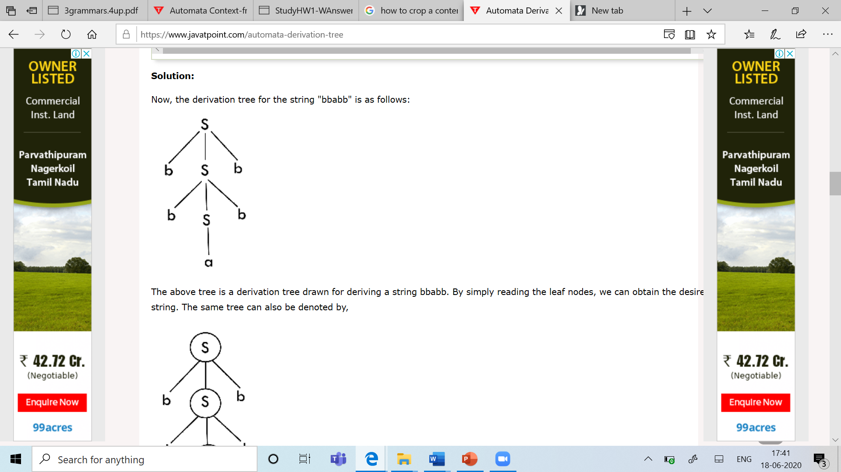
2. Draw a derivation tree for the string "bab" from the CFG given by
P: S → bSb | a | b
Derivation Tree
String : bbabb
S=>bSb
=>bbSbb
=>bbabb

Slide 23
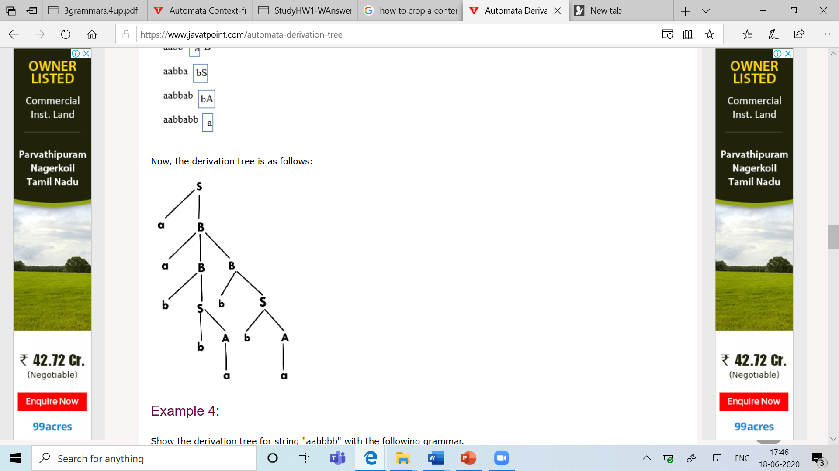
3. Draw a Parse Tree for the string " aabbabba " from the CFG given by
P:S → aB | bA Derivation tree
A → a | aS | bAA
B → b | bS | aBB
String=aabbabba
S=>aB
=>aaBB
=>aabSB
=>aabbAB
=>aabbaB
=>aabbabS
=>aabbabbA
=>aabbabba

Slide 24
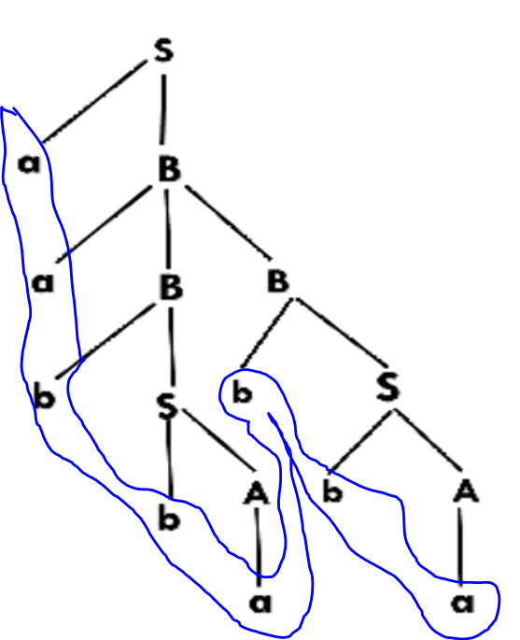
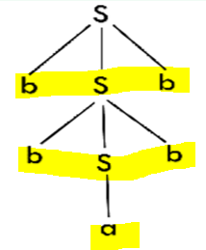
Parse Tree
Yield of a Tree:
It is the string obtained by reading the leaf's from left to right without considering null symbol.
Sentinel Form : Every step in the derivation

Slide 25
Ambiguity in Grammar
A grammar is said to be ambiguous if there exists more than one LMD or more than one RMD.
More than one parse tree for the given input string.
If the grammar is not ambiguous, then it is called unambiguous.
Drawback:
If the grammar has ambiguity, then it is not good for compiler construction.

Slide 26
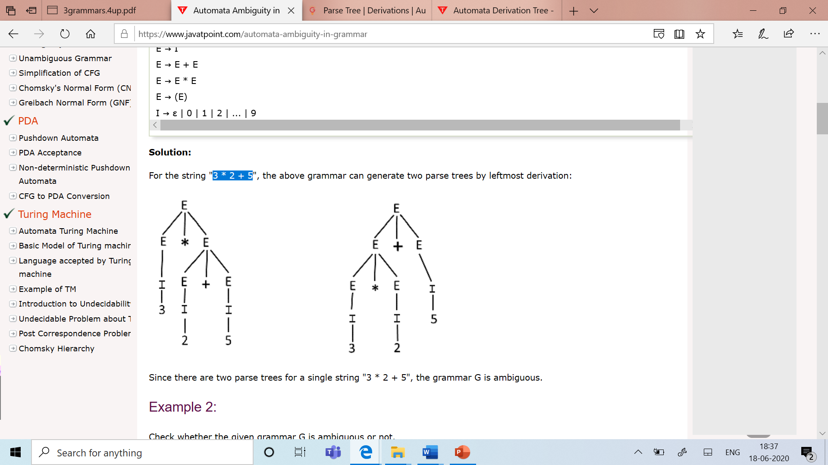
Example
1. Check the given Grammar is ambiguous or not
P: E → I
E → E + E DT-1 DT-2
E → E * E
E → (E)
I → ε | 0 | 1 | 2 | ... | 9
String: 3 * 2 + 5
Hence G is ambiguous

Slide 27
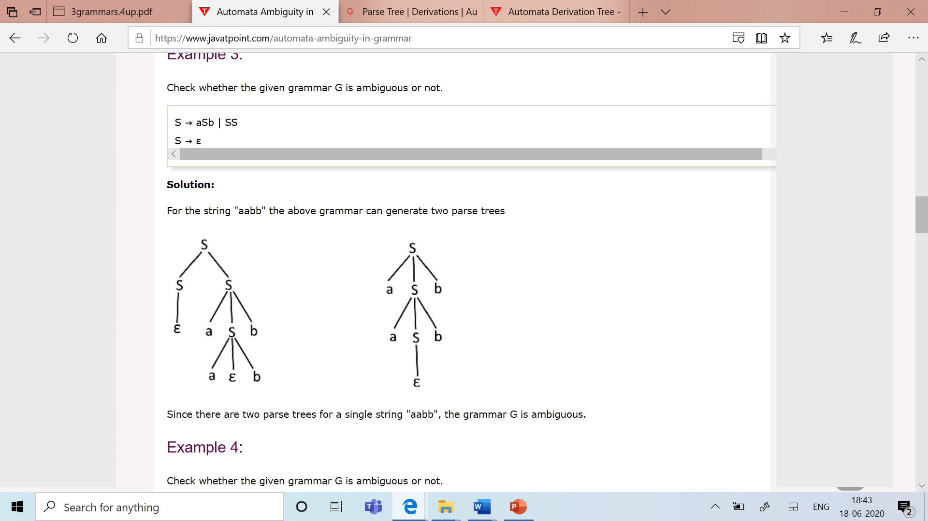
2. Check whether the given grammar G is ambiguous or not.
P: S → aSb | SS DT1 DT2
S → ε
String =aabb
Hence G is Ambiguous Grammar

Slide 28
Unambiguous Grammar
A grammar can be unambiguous if the grammar does not contain ambiguity.
Example
P: S → S + A
A → A * B | B
B → C ^ B | C
C → a

Slide 29
Chomsky's Normal Form (CNF)
A CFG is in CNF if all production rules satisfy one of the following conditions:
A non-terminal generating two non-terminals.
example, S → AB.
A non-terminal generating a terminal. For example, S → a.
Example G:
G1 = {S → AB, S → c, A → a, B → b} --CNF
G2 = {S → aA, A → a, B → c} ----- not in CNF

Slide 30
Example
1. G= {S → aA, A → a, B → c} Convert to CNF
Solution:
Step 1: Eliminate start symbol from the RHS.
S1 → S Where S1 is the new start symbol.
Step 2: In the grammar, remove the null, unit and useless productions.
No Null Production

Slide 31
Step 3: Eliminate terminals from the RHS of the production if they exist with other non-terminals or terminals.
For example, production
S → aA can be decomposed as:
S → RA
R → a
Step 4: Eliminate RHS with more than two non-terminals.
For example,
S → ASB
can be decomposed as:
S → RS
R → AS

Slide 32
1. Convert the given CFG to CNF. Consider the given grammar G1:
S → a | aA | B
A → aBB | ε
B → Aa | b
Solution:
Step 1: We will create a new production S1 → S, as the start symbol S appears on the RHS.
The grammar will be:
S1 → S
S → a | aA | B
A → aBB | ε
B → Aa | b
Step 2: Removal of null productions. As grammar G1 contains A → ε null production
S1 → S
S → a | aA | B
A → aBB
B → Aa | b | a

Slide 33
Now, as grammar G1 contains Unit production S → B, its removal yield:
S1 → S
S → a | aA | Aa | b
A → aBB
B → Aa | b | a
Also remove the unit production S1 → S, its removal from the grammar yields:
S1 → a | aA | Aa | b
S → a | aA | Aa | b
A → aBB
B → Aa | b | a

Slide 34
Step 3: In the production rule
S0 → aA | Aa,
S → aA | Aa,
A → aBB
B → Aa,
terminal a exists on RHS with non-terminals. So we will replace terminal a with X:
S0 → a | XA | AX | b
S → a | XA | AX | b
A → XBB
B → AX | b | a
X → a

Slide 35
S0 → a | XA | AX | b
S → a | XA | AX | b
A → XBB
B → AX | b | a
X → a
Step 4: In the production rule
A → XBB,
RHS has more than two symbols, removing it from grammar yield:
S0 → a | XA | AX | b
S → a | XA | AX | b
A → RB
B → AX | b | a
X → a
R → XB
Hence the given grammar is converted to CNF

Slide 36
Greibach Normal Form (GNF)
A CFG(context free grammar) is in GNF(Greibach normal form) if all the production rules satisfy one of the following conditions:
A non-terminal generating a terminal.
For example, A → a.
A non-terminal generating a terminal which is followed by any number of non-terminals.
For example, S → aASB.
Example :
G1 = {S → aAB | aB, A → aA| a, B → bB | b} --GNF
G2 = {S → aAB | aB, A → aA | ε, B → bB | ε} --not GNF

Slide 37
Steps for converting CFG into GNF
Step 1: Convert the grammar into CNF.
Step 2: If the grammar exists left recursion, eliminate it.
Step 3: In the grammar, convert the given production rule into GNF form.

Slide 38
1. Convert the given Grammar to GNF
S→ XB | AA
A → a | SA
B → b
X → a
As the given grammar G is already in CNF and there is no left recursion,
Skip step 1 and step 2 and directly go to step 3.

Slide 39
S→ XB | AA
A → a | SA
B → b
X → a
Step 3: The production rule A → SA is not in GNF,
S → XB | AA
A → a | XBA | AAA
B → b
X → a
The production rule S → XB and B → XBA is not in GNF
S → aB | AA
A → a | aBA | AAA
B → b
X → a

Slide 40
Now we will remove left recursion (A → AAA), we get:
S → aB | AA
A → aC | aBAC
C → AAC | ε
B → b
X → a
Now we will remove null production C → ε, we get:
S → aB | AA
A → aC | aBAC | a | aBA
C → AAC | AA
B → b
X → a

Slide 41
The production rule S → AA is not in GNF,
S → aB | aCA | aBACA | aA | aBAA
A → aC | aBAC | a | aBA
C → AAC
C → aCA | aBACA | aA | aBAA
B → b
X → a
The production rule C → AAC is not in GNF,
S → aB | aCA | aBACA | aA | aBAA
A → aC | aBAC | a | aBA
C → aCAC | aBACAC | aAC | aBAAC
C → aCA | aBACA | aA | aBAA
B → b
X → a
Hence the given grammar is in GNF

